Slide 1
Self trip
Malibu Creek State Park
After trip review
Scott Holloway – Westlake High School

Slide 2
After your visit
Here are some of the observations I made while on my visit.
I really enjoy this park and hope I opened your eyes to what a special place it is we live in.
Keep getting out there and bring a friend to show what you learned.

Slide 3
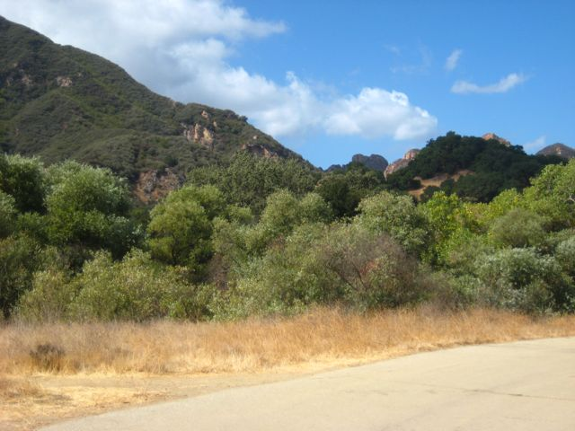
Chaparral Biome Adaptations
Organisms need to be able to handle:
  Short mild winters
  Long hot summers
  Occasional drought
  Occasional fire
  Coastal influence
  Low precipitation
Here are some of their adaptations

Slide 4
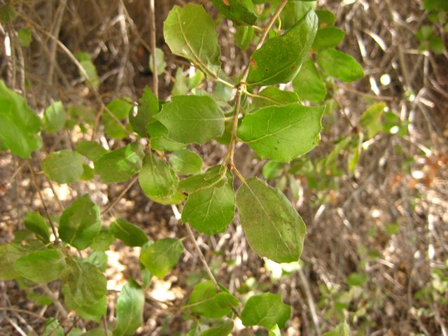
Scrub Oak
The leaves of the scrub oak are waxy to reduce/prevent evaporation.
The leaves are edged with small spines to reduce the chance of being eaten.
The tree is evergreen in order to take advantage of the ample light all year long.

Slide 5
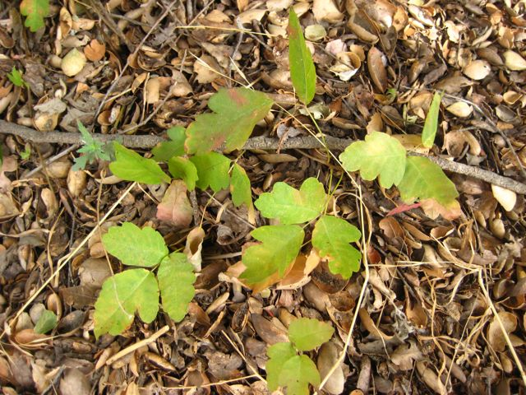
Did you notice
Beware!
Although not deadly, poison oak can really ruin your day/week
Leaves of three, let it be…unless its hairy (small thorns on stems and leaves) then it’s a berry (usually blackberry)

Slide 6
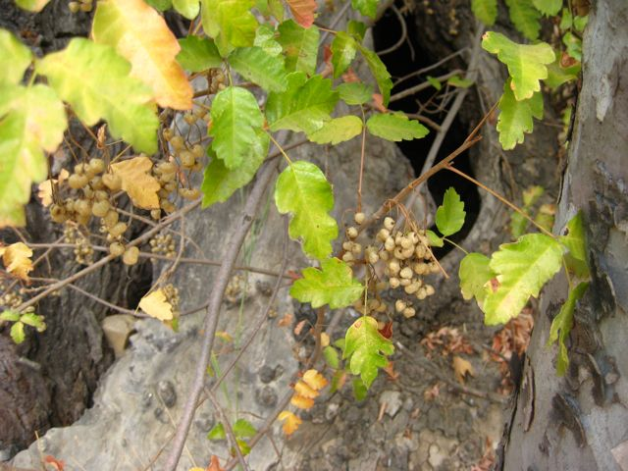
Poison Oak Berries
Poison Oak spreads quickly
Seeds as well as runners (special roots that run along the surface or just beneath that form new plants) allow the plant to prosper
Poison Oak likes water and usually found near creeks

Slide 7
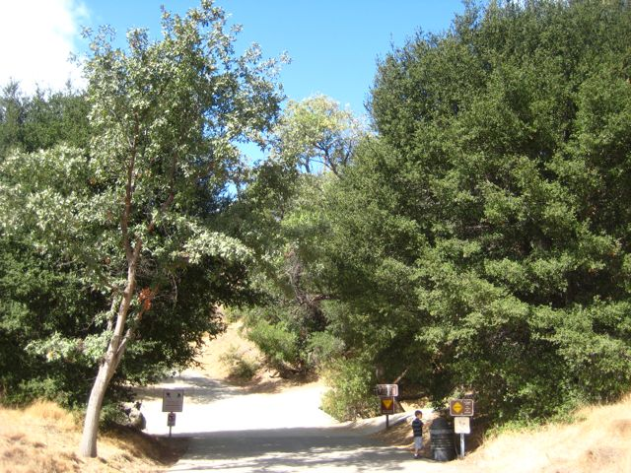
Deciduous vs. Evergreen
Oak on the left (Valley Oak) is deciduous and goes dormant during the winter, conserving energy
Oak on the right (Coast Live Oak) is evergreen and can continue to grow all year long. This tree is slow growing.

Slide 8
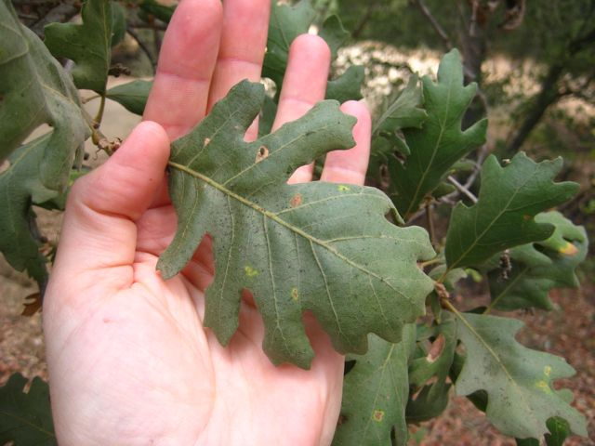
Valley Oak
Valley Oaks are faster growing and produce a large number of acorns
The acorns are eaten by a large number of animals
Some of the acorns are buried for later and have a better chance of growing into another tree

Slide 9
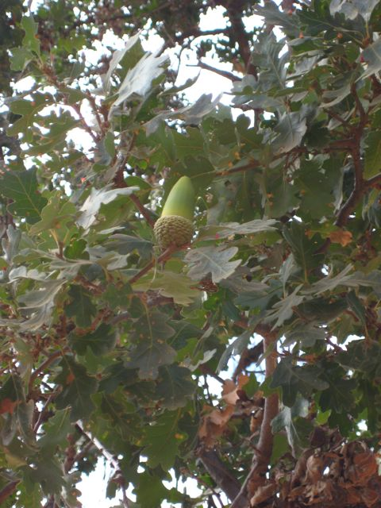
The Valley Oak Acorn
Looks yummy
Okay, maybe not to you
Chumash in the area used to use these for food very often.
From what I have heard they are very bitter to bland

Slide 10
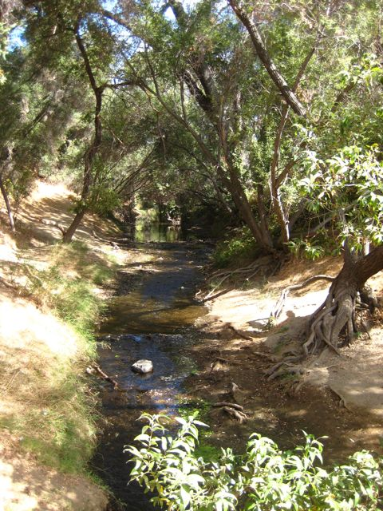
The creek crossing
This area is called a riparian zone.
Lush vegetation grows due to greater amounts of water
Most of these trees are the fast growing Arroyo Willows

Slide 11
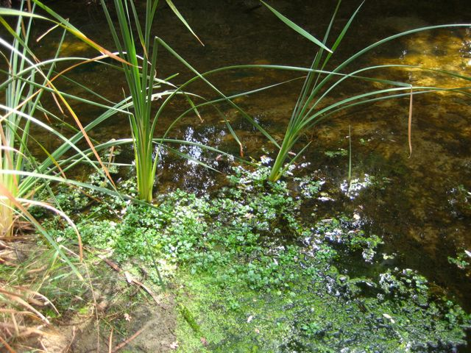
Cooler temperatures
The shade acts like a natural air conditioner providing a cool shelter for many animals
Also many aquatic “bugs” and frogs help support the food chain

Slide 12
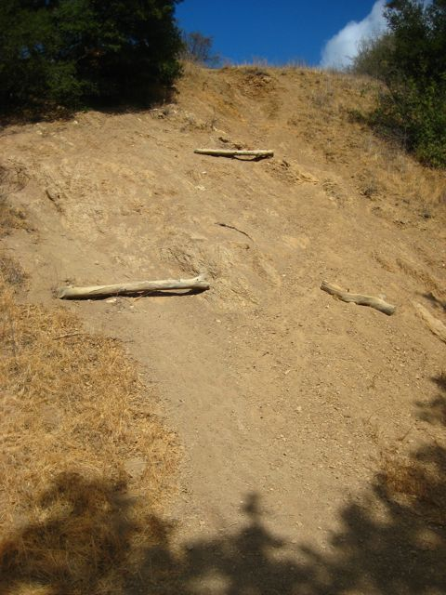
Erosion
One of the problems in the park is erosion
Here “hikers” have tried to make a new trail and have left the hill vulnerable to erosion
Please stay on established trails only

Slide 13
Notice the variety
As you walk next to the creek you will see several types of tree including:
  Arroyo willow
  California black walnut
  Western sycamore
  Valley oak
  Coast live oak
  Scrub oak

Slide 14
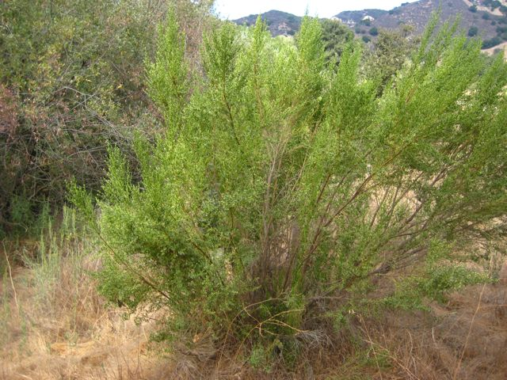
Coyote Bush
This Chaparral plant has very waxy small leaves
Evergreen and grows near creeks typically
In late spring, the bush releases thousands of seed with small tufts (similar to dandelions)

Slide 15
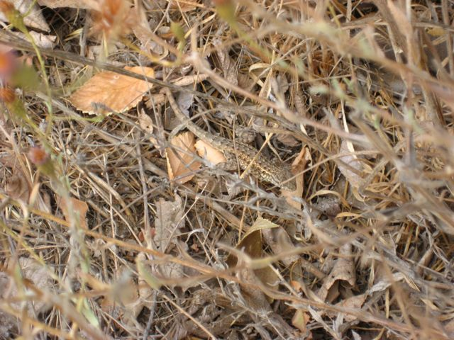
Look closely
A Western fencepost lizard is in the center of the picture
Camouflage helps lizards avoid being eaten by birds while warming in the sun or hunting insects
This is one of several lizards that can lose their tail and it will grow back

Slide 16
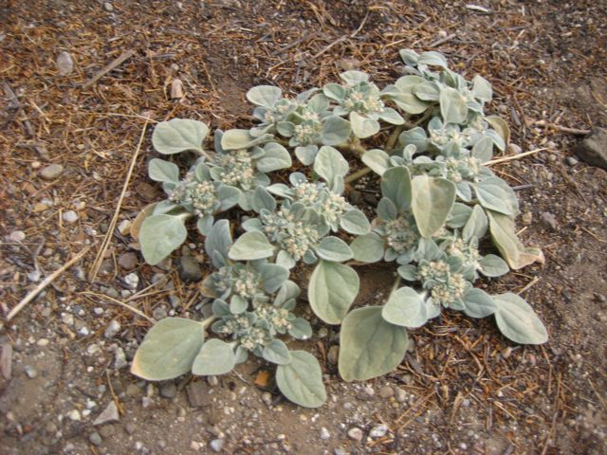
Dove weed
Many plants in the park have light color, typically blue-green
Leaves are thick
Covered in small fur
These adaptations help conserve water in the semi-arid conditions

Slide 17
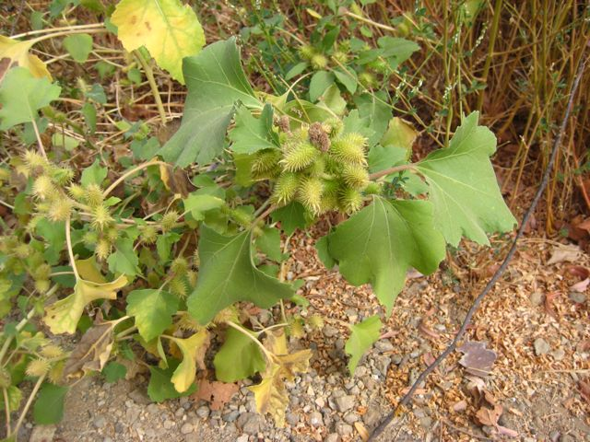
Watch out for burrs
This plant has burrs, nature’s version of Velcro that grabs on to passing animal fur
This helps to spread large seed pods over great distances

Slide 18
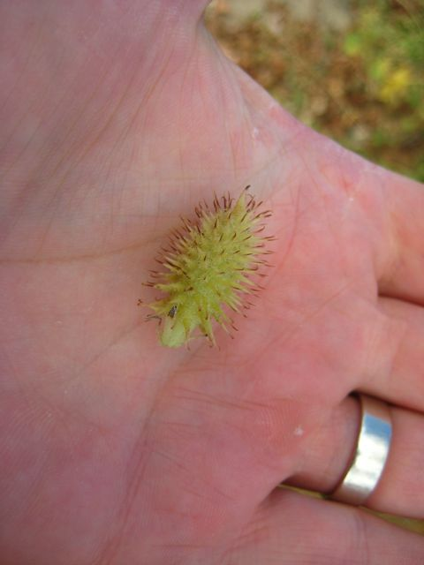
This one is still green
I pricked my finger on the sharp spines covering the seed pod
This also prevents animals from eating and damaging the seeds inside

Slide 19
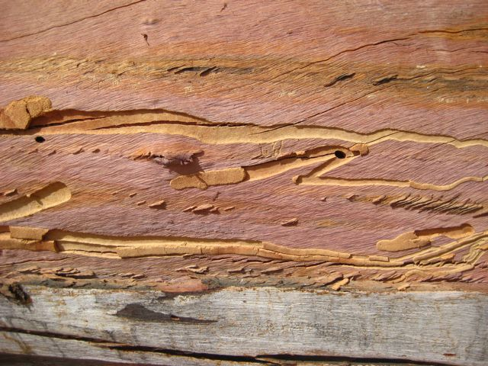
Some organisms are rarely seen
Some beetles lay eggs in the bark of trees
The larvae then bore/eat their way through the tree over a long period of time
This is a piece of Eucalyptus that shows many bore trails

Slide 20
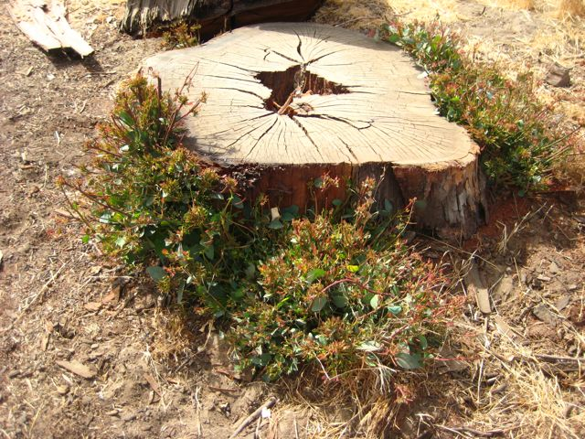
Recovery
Here is the stump of the Eucalyptus and already new growth is forming
Although not native, Eucalyptus grows in Chaparral biomes in Australia
Many Chaparral plants regrow from roots still alive
This is important for surviving frequent fires

Slide 21
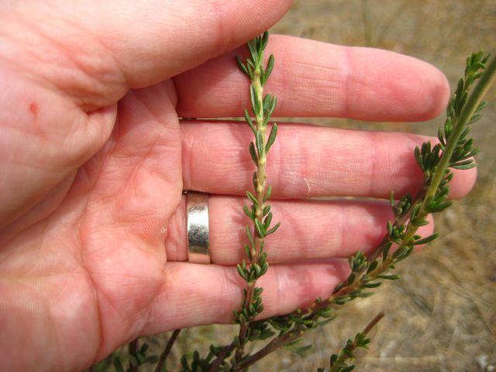
Small needle-like leaves
California Buckwheat has small oily leaves that help conserve water
The plants in the Chaparral are not often considered lush, but have a this scraggly appearance

Slide 22
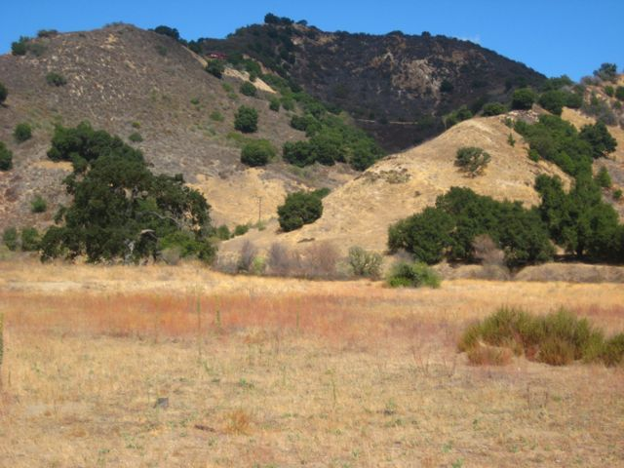
Meadows
Often look bleak at the end of the dry season
Looking carefully one will find that plants are still alive
Many native grasses are perennial (live longer than one year)
Unfortunately, many grasses here are non-native

Slide 23
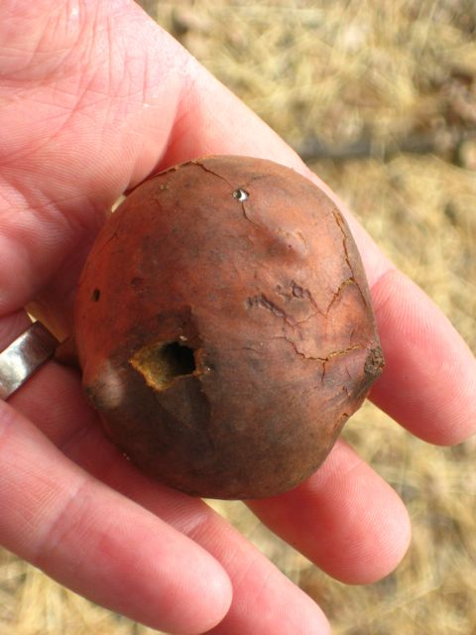
An Oak Gall
This light weight “foam” ball is called a gall
Formed by a small wasp laying an egg in soft green bark on oak trees
A cancer-like tumor grows on the tree offering protection to the larva inside
This seems to have little affect on the oak overall

Slide 24
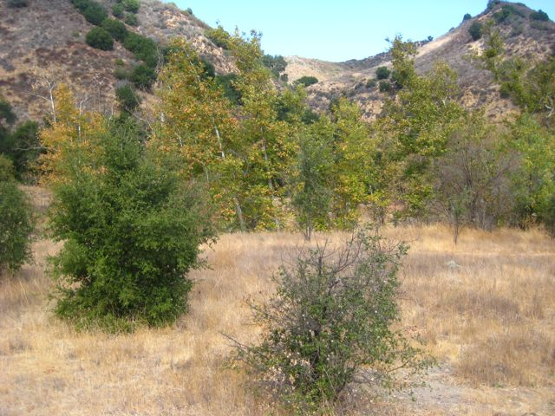
Western Sycamores
The trees in the background are western sycamores
The love water and are rarely found for from a reliable water source
Chumash used to use sycamores as markers for water sources, sometimes tying them in the shape of an X
Sort of like an early “In-n-Out”

Slide 25
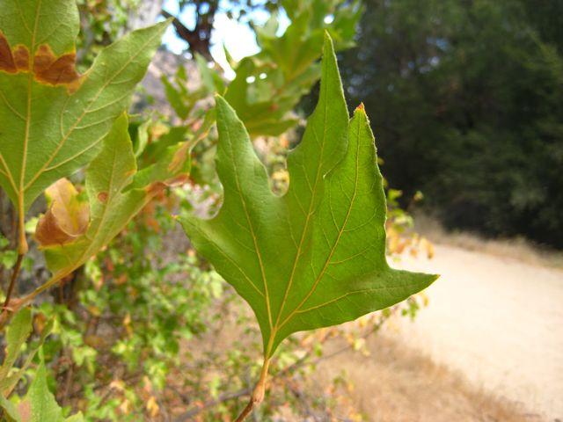
Western Sycamore
As a deciduous tree, the leaves are thin and broad
The bark is also thin and light in color (gray to white)
Seeds form as four “pom-poms” that hang from the tree

Slide 26
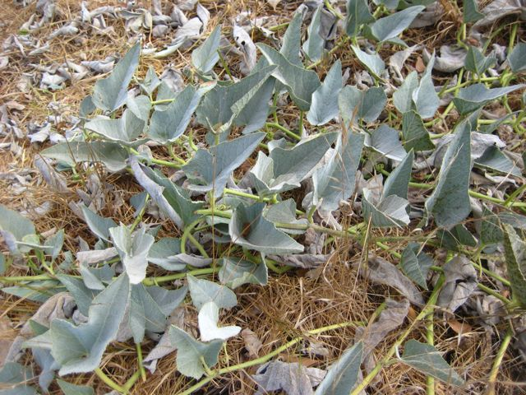
Wild Squash
Animals or maybe people have already removed the gourd-like squash from this plant
A food source and annual, the plant benefits from having the fruit eaten and depositing seed and fertilizer someplace else

Slide 27
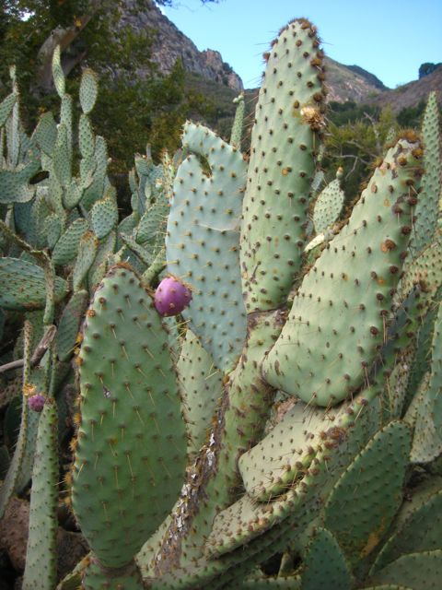
Prickly Pear Cactus
Considered by some to be invasive
I was told that migration is considered natural and not anthropogenic (human created)
The purple fruit is sweet and eaten by birds and other animals

Slide 28
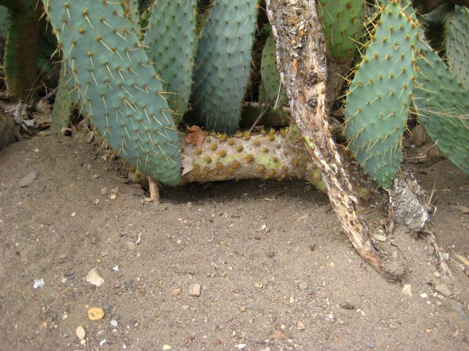
An armored fortress
Some animals create burrows under such cacti for protection
It does not take a coyote long to realize not to follow a rodent into this burrow

Slide 29
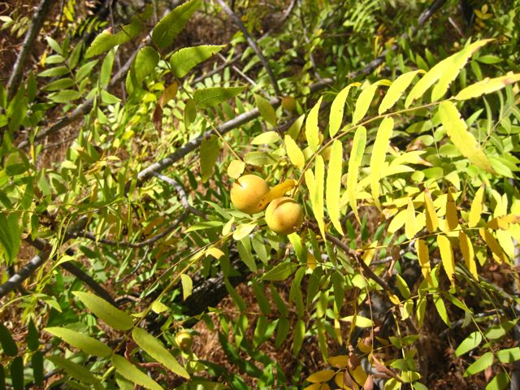
California Black Walnut
The seeds on the black walnut are difficult to open and can last for several years
Fall/winter foliage is beautiful as green chlorophyll dies showing bright yellows and oranges

Slide 30
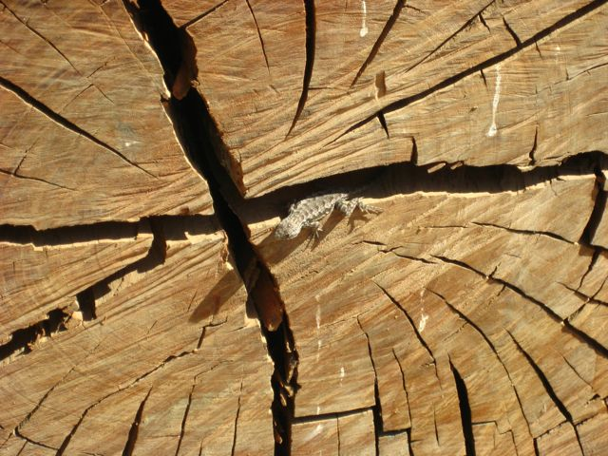
Lizards are everywhere
When the weather warms during the day lizards can be seen in many places
Many lizards hibernate during cold winter months (January/February)
Young are born in the beginning of summer to take advantage of the large number of insects

Slide 31
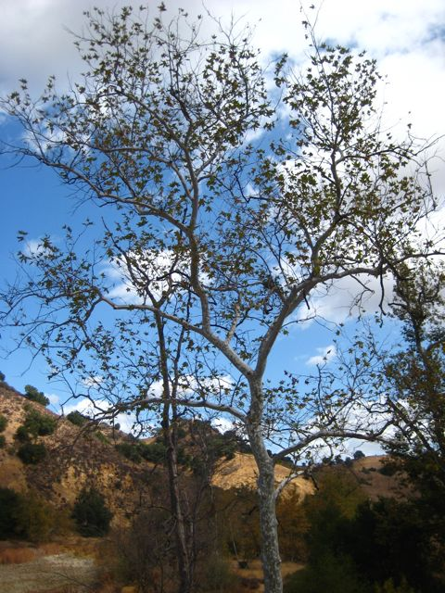
Western Sycamore
The tree looks very different than the more prevalent oaks in the area

Slide 32
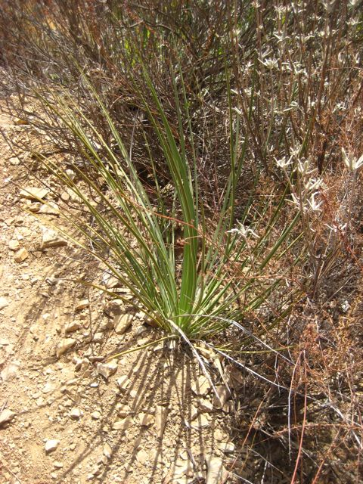
Thick long spiny leaves
Yucca Chaparral “Our Lords Candle” is flowering in late spring.
Most live only two years
This is a new plant that will grow this year into a larger, but similar plant
The following year a large shoot will grow out of the center and flower

Slide 33
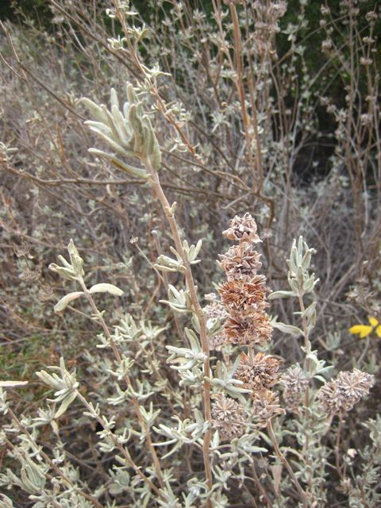
White Sage
Like many other plants the White Sage is perennial
Light color and sparse “furry” leaves conserve water
During the dry season the plant looks almost dead but is in a very slow growing state

Slide 34
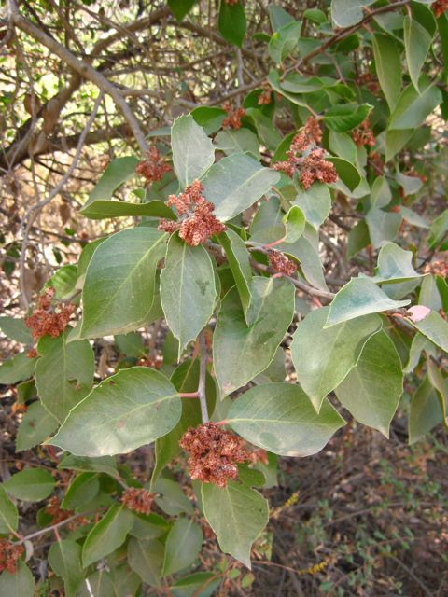
Lemonade Berry
Related to the sumac family
Leaves are thick and waxy
Berries (not in season hear) were used by Chumash in a drink
Berries are pink in early summer

Slide 35
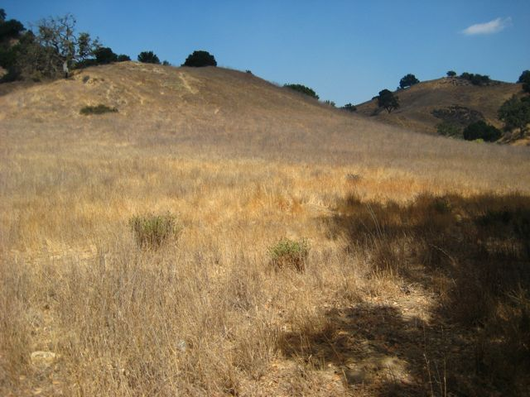
A Southern Aspect
Facing the sun all day tends to dry the soil
Plants that grow here can handle higher temps and less moisture

Slide 36
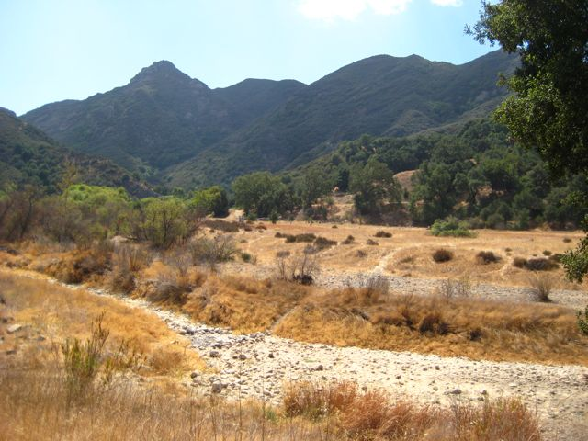
Northern Aspect
Look at the mountain in back
The majority of the green is Ceanothus
Ceanothus needs cooler temps and prefers the Northern Aspect because it experiences more shade, hence cooler and less evaporation

Slide 37
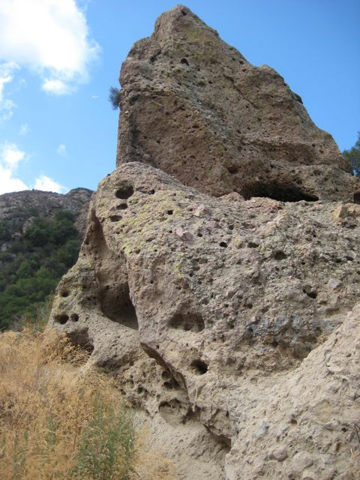
Great Geology
While exploring the park, keep an eye out for some great geologic formations
You are standing on a long dead volcano after all.
But that’s a self trip for another day

